Slide 2
Inspiration
What inspires you? There are a lot of things that can provide inspiration –
seeing other people accomplish great things,
seeing other people overcome adversity,
hearing inspirational quotes from great people,
even the sheer beauty of nature can remind us just how lucky we are to be alive.

Slide 3
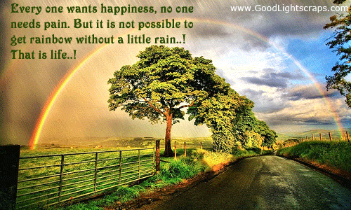
Amazing gift of life
It’s easy to forget what an amazing gift life really is.
Our lives are nothing but a cosmic blink.
Even our seemingly all-encompassing world is just tiny blue dot circling an average sized star spiraling around a galaxy of 200-400 billion stars, which itself is just one galaxy among billions more.
Yet for one brief moment, we get to experience the wonders of existence, of consciousness.

Slide 4
POSITIVE OUTLOOK
Having a positive outlook on life is a crucial part of finding inspiration. In the paragraph above, did you feel inspired reading about the vastness of our universe and our unique place within it, or did you feel overwhelmed and depressed at the insignificance of it all?
Our brains are wired to find things we’re looking for – if you’re always cynical or waiting for things to go wrong, then your life will reflect that. On the other hand, having a positive outlook on life will bring you joy and provide you with inspiration when you least expect it.

Slide 5
Hungry for success
“The biggest startup successes-from Henry Ford to Bill Gates to Mark Zuckerberg-were pioneered by people from solidly middle-class backgrounds. These founders were not wealthy when they began. They were hungry for success, but knew they had a solid support system to fall back on if they failed.” -Eric Ries

Slide 6
“Excellence is an art won by training and habituation.
We do not act rightly because we have virtue or excellence, but we rather have those because we have acted rightly.
We are what we repeatedly do. Excellence, then, is not an act but a habit.”
–Aristotle

Slide 7
Imagination
“The great successful men of the world have used their imagination. They think ahead and create their mental picture in all its details, filling in here, adding a little there, altering this a bit and that a bit, but steadily building – steadily building.”
–Robert Collier

Slide 8
How far you go in life…..
“How far you go in life depends on your being tender with the young, compassionate with the aged, sympathetic with the striving and tolerant of the weak and the strong. Because someday in life you will have been all of these.”
–George Washington Carver

Slide 9
“Change your thoughts and you change your world.”
–Norman Vincent Peale

Slide 10
“Your time is limited, don’t waste it living someone else’s life. Don’t be trapped by dogma, which is living the result of other people’s thinking. Don’t let the noise of other’s opinion drowned your own inner voice. And most important, have the courage to follow your heart and intuition, they somehow already know what you truly want to become. Everything else is secondary.”
–Steve Jobs

Slide 11
“Nobody can go back and start a new beginning, but anyone can start today and make a new ending.”
–Maria Robinson

Slide 12
“Out of clutter, find Simplicity. From discord, find Harmony. In the middle of difficulty lies Opportunity.”
–Albert Einstein

Slide 13
“Yesterday is not ours to recover, but tomorrow is ours to win or lose.”
–Lyndon Johnson

Slide 14
If your actions inspire others
to dream more
learn more,
do more
and
become more
You are a leader
-John Quincy Adams

Slide 15
Learning brings humility,
Humility develops capability
Capability brings wealth
and
Wealth and righteousness brings happiness.

Slide 16
Life affords no higher pleasure than that of surmounting difficulties, passing from one step of success to another, forming new wishes and seeing them gratified.
-Samuel Johnson

Slide 17
“The tragedy in life doesn’t lie in not reaching your goal. The tragedy lies in having no goal to reach.”
–Benjamin Mays

Slide 18
What should be done?
“Keep away from people who try to belittle your ambitions. Small people always do that, but the really great makes you feel that you, too, can become great.”

